Slide 1
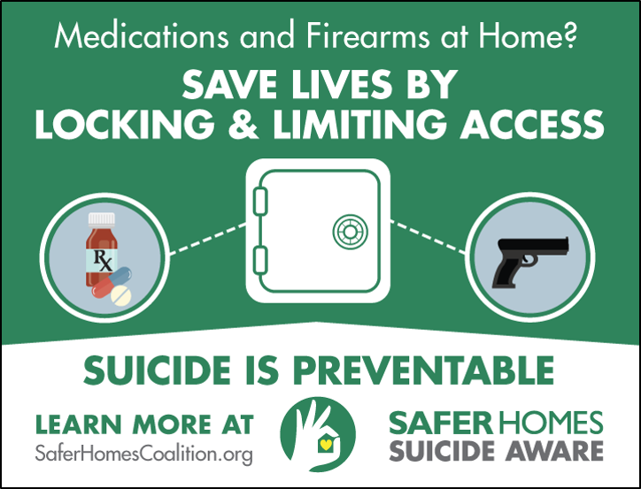
Lethal Means Safety
Required:
*per AFMAN31-101 As part of the awareness campaign unit commanders will promote the use of gun locks for privately owned firearms as a matter of general household safety and risk reduction
Notes:
If you can add Time to how long it takes to access any lethal means (gun, medications, etc.) AND, Distance between your family, friends or Airmen in crisis and a firearm or medications…we take deliberate steps to reduce the risk of suicide attempts and save a life.
Remember, “Go S.L.O Safes, Locks or Outside the home storage of lethal means” Every minute of delay increases the family, friend, or coworker’s chance of living. If someone you know is in distress, help keep lethal means (firearms, medication, sharp objects, etc.) away from them until they recover. Example: It’s like holding a friend’s car keys when they are drunk.

Slide 2
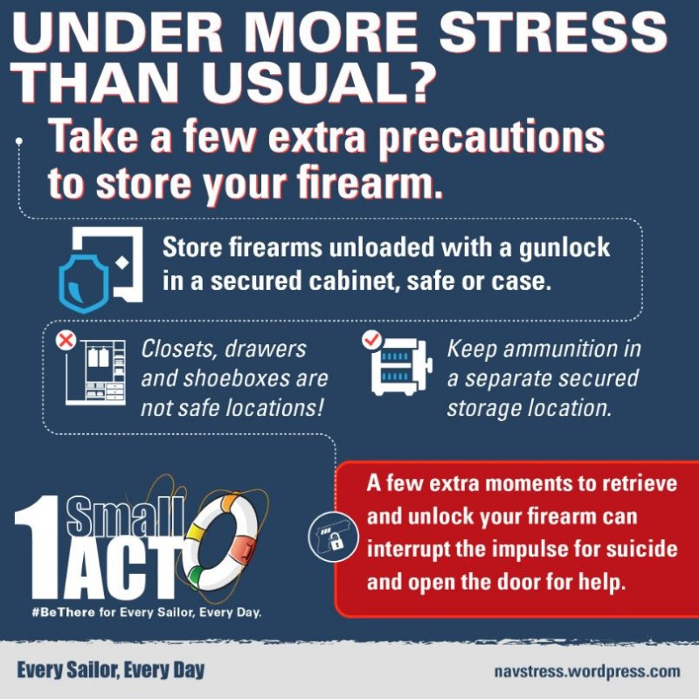
Time-Based Prevention
Firearms
Because firearms are the most lethal among suicide methods, it is particularly important that you:
Remove them until things improve (best option), OR
Lock them very securely
Notes:
5 minutes is all it can take to save a life – 5 minutes from the time someone grabs their firearm and proceeds to take an action against themselves – 5 minutes is worth someone's life. Do you know where you can get a cable lock on base? Jen Baldwin, DPH office, and the Safety Office in 408.

Slide 3
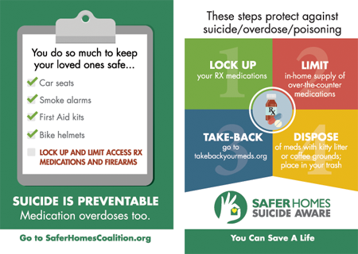
Time-Based Prevention
Medications
Don’t keep lethal doses at home.
Be particularly aware of keeping prescription painkillers like oxycodone and hydrocodone under lock and key both because of their lethality and their potential for abuse.
Properly dispose of medications using takeaway bags
.
Notes:
Ask your DDRPM for medication disposal bags – please don’t flush medication or throw it away especially if it’s a controlled substance.

