Slide 1
How to Facilitate Small Group Discussions
Facilitator Training

Slide 2
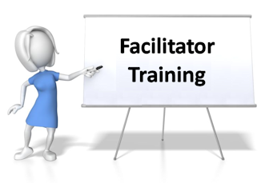
Purpose
Facilitation might seem intimidating and this topic can be challenging therefore we have put together this training presentation about facilitating a group discussion to assist you in leading your small group discussions.
Role of Facilitator
Starting Off
Facilitation Tips

Slide 3
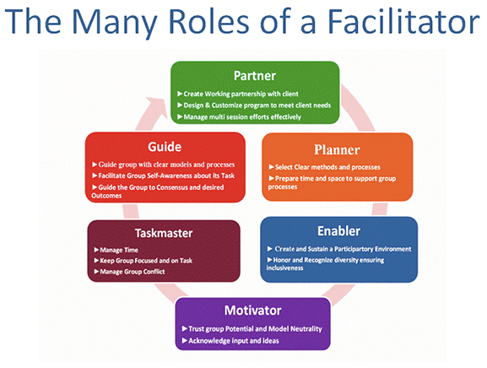
Understanding the Role of the Facilitator

Slide 4


Understanding the Role of the Facilitator
Stay Neutral
Your role is to create the process and conditions that enable the group to discuss the topic openly
Conduct the discussion without trying to direct the group to a particular outcome
This does not mean that you are neutral and have no opinions, but as a facilitator you need to play an objective role
Achieve the learning objectives
You should strive to bring out the voices in the group
Allow the group to explore the subject but it is your job to ensure all talking points are covered and feedback on each topic is gathered
Consider structuring the discussion, rather than allowing a free-for all, to ensure greater participation
Round robin – go around the group allowing each person to speak in turn
Smaller group discussions - break bigger groups (9-20) into smaller groups to discuss topics and then report back to larger group
Smaller groups ensure greater participation

Slide 5
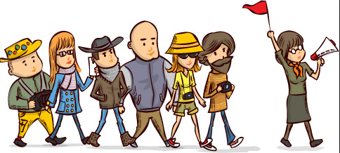
Understanding the Role of the Facilitator
Guide the Discussion
Focus on the group process
Is the group repeating itself?
Are all members who wish to participating?
Is the discussion staying on track and on time?
Focus on improvement – ask for ways to improve “here is how to make it better”
Summarize what is being said
Ask questions to open up discussion or to think about new directions
Closed-ended questions (yes/no or factual) are useful for summarizing or reality checks
Open-ended questions (how, what, why, tell me, describe) draw people out

Slide 6
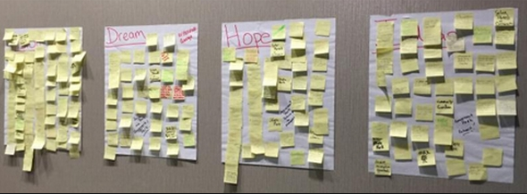
Understanding the Role of the facilitator
Record the discussion in a visible way
If possible, consider recording the discussion in a way that is visible to the group
Using flip charts or having people write their thoughts on sticky notes and adding them under the topics can be great visuals of the feedback
Having the discussion visible helps the group to see the progress it's making and to refer back to earlier comments
Note: Whenever possible, use the speaker's own words, and be sure to record everyone's comments to avoid creating tension and resistance
Note: Having someone else write and capture ideas while you facilitate might be helpful

Slide 7

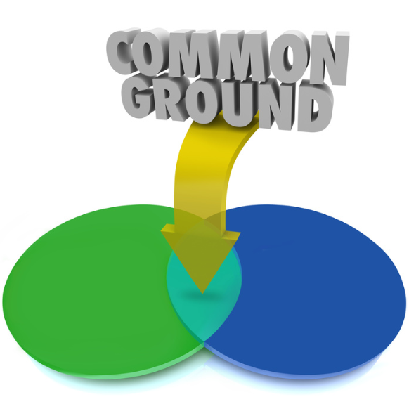
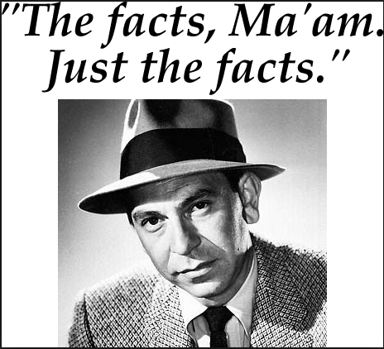
Understanding the Role of the Facilitator
Ensure Productive Group Behaviors
Include everyone
Be sure all members have an opportunity to be heard
Look for common ground
Deal with conflict by talking about the facts
Examples:
"It sounds like we have a difference of opinion here."
"What do we know about the situation?"
"What concerns do people have?"
"How does the current situation affect your ability to make this decision?"
Summarize the Results
Summarize key points at the end of the session

Slide 8

Starting Off

Slide 9

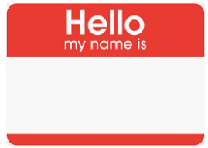
Starting Off
Introduce the purpose of the discussion and ensure that the participants have the same understanding
Explain the organization and structure (including the time line) of the discussion
Explain your role as facilitator
A person whose role it is to remain neutral or objective, to keep the discussion focused and energized and to create an environment for all to have a chance to participate
Do introductions
How you do the introductions will help set the tone for the discussion--the amount of information and the degree of self-disclosure that will occur.

Slide 10
Starting Off
Set the appropriate tone
Show your comfort with the topic so that others feel comfortable
Create a safe and open environment so that the participants will feel comfortable and share their views openly and honestly
"I am here to help us have a good discussion about .... We are here to learn from one another, to get a sense about how we think and feel about ...., and to help us make stronger and deeper connections with one another. My job as a facilitator is to help us have a good discussion where all views can be voiced in a safe and respectful environment. That doesn't mean that there won't be disagreement and some tension about important issues. I hope that you will say what is on your mind. I understand the challenge we all face in sharing some of our experiences and vulnerabilities with each other. To create a safe and respectful atmosphere we ask that all of us follow a few ground rules."

Slide 11
Starting Off
Establish ground rules for the discussion so that the participants feel the environment is safe to speak about their ideas and feelings.
Ground rules should be explicit
Ask the group if these rules make sense and if everyone can honor them
The following are some suggestions (create your own list):
We ask that you speak from your own perspective
We ask that you respect the viewpoints of others
We ask that you maintain confidentiality about what is said in the room during this discussion
To show your respect for others in the room, we ask that you stay focused on the discussion and avoid side conversations
We ask that you be willing to voice disagreements, but we ask that if you disagree with someone's idea that you criticize the idea, not the person
We ask that you don't interrupt each other

Slide 12
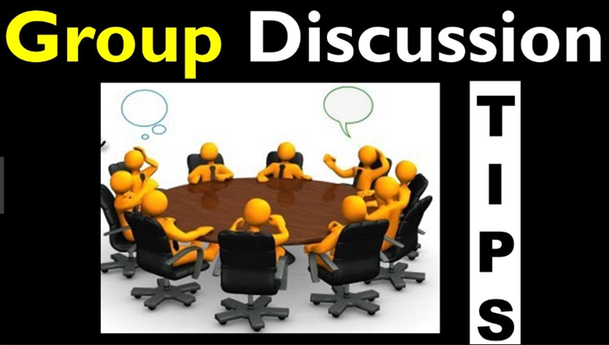

Slide 13
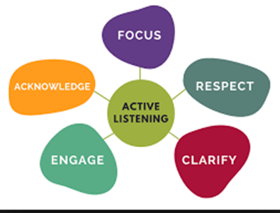

Group Discussion Tips
Active listening/paraphrasing
Paraphrasing means repeating the essence of what a participant has said in order to make them feel understood
Sometimes, this means summarizing a lengthy oratory, and making it concise and clear so that others can understand it
“So, what you’re saying…”
Check for Meaning
As this topic can make people uncomfortable, sometimes an individual will make a statement that sounds combative, even when they don’t mean it that way
Make sure you understand what they’re saying and avoid getting defensive or combative yourself
“Are you saying…? I’m not sure that I understand what you mean.”

Slide 14


Group Discussion Tips
Give Positive feedback
Compliment an interesting or insightful comment
Always thank people for sharing
“That’s a good point. I’m glad you brought that to our attention.”
“That’s interesting. I’m glad you shared that, because if you’re thinking that, it’s possible others could be too. Does anyone else share that belief?”
Redirection
Sometimes the point may not be a good one or may take you way from the goal of that segment.
“Okay. I get how you would want to know that (or talk about that) but I think we need to stay focused on the topic at hand. If we have time later, we can return to that idea, or feel free to ask me about that after the group.”
“I appreciate your willingness to share a personal example, but as we don’t have a lot of time during the group, let’s get back to the topic and maybe you and I could discuss your experience after class.”
Give a two-minute warning or some other transition time to prepare the group to change direction

Slide 15

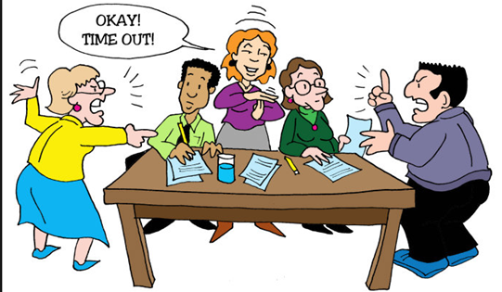
Group Discussion Tips
Expand
Elaborate on a participant’s contribution to the discussion with examples, or suggest a new way to view the problem.
“Your comments provide an interesting point. How do you think other might perceive the situation?”
Tell me more
Devil’s Advocate
Disagree (respectfully) with a participant’s comments to stimulate further discussion
“I can see where you are coming from, but I’m not sure that what you are describing is always the case. Can you (or another participant) play “Devil’s Advocate” with me, and argue the opposite of what you just stated.”
Relieve Tension
Mediate differences of opinion between participants and relieve any tensions that may be brewing
“I think that the two of you are not really disagreeing with each other but are just bring out two different perspectives about a tough issue.”

Slide 16
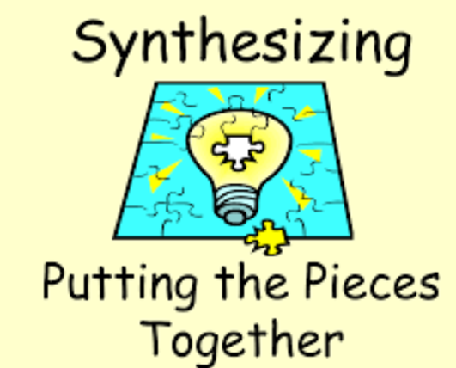
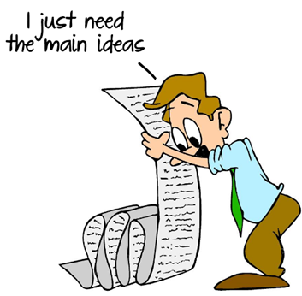
Group Discussion Tips
Synthesize
Pull together ideas, showing their relationship to each other
“What you’re saying now ties back to what we discussed at the beginning…”
Summarize
Summarize (and record) the major view of the group
“So here’s what you’re saying…”
Containment
Sometimes, one or more individuals will try to “run the show”, dominating the discussion
It’s important that you make the room a safe place for all, and that will mean containing the big talkers
“Again, you are bringing a lot of really interesting stuff to the table. But if you could help me out, I really want to make sure everyone gets a change to contribute. I promise we’ll get back to you.”
"In order to accomplish our goal today, we really need to move on. Perhaps we can go back o this topic later.“
Avoid statements like, “Let’s hear from someone else other than Rick.” Instead, if you determine you have 1-2 louder people in the group, set a broader expectation like, “Let’s hear perspectives from four different people on this.”

Slide 17

Group Discussion Tips
Protection
There is a strong likelihood that there will be members of your group who have been touched directly or indirectly by this topics
This may prompt some to be more vocal and others more introverted, be sensitive to what may drive either behavior
Don’t insist that quieter people speak
Watch for eye-contact, facial expressions, and subtle motions that the quieter people might make when they are ready to talk — and then ensure that have a chance to speak
“I know this is a hard topic for some people to talk about. I just want to reiterate that we really want to hear everyone’s perspective, with as much as they feel comfortable in sharing.”

Slide 18
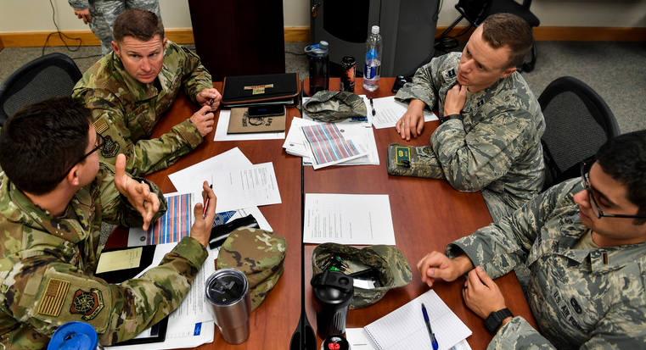
Final Thoughts
Remember, offer all members the opportunity to go to the https://www.resilience.af.mil/OpTHURSDAY to fill out the feedback sheet and submit directly to HAF/A1Z or if they choose, submit via email to: usaf.resilience@mail.mil
While there is no way to give you all the answer to all of the questions you may have about facilitating small group discussion, we hope this provides you with a solid foundation from which to begin.

Slide 19


