Slide 1
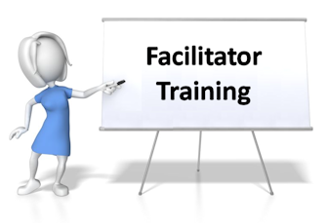

Slide 2
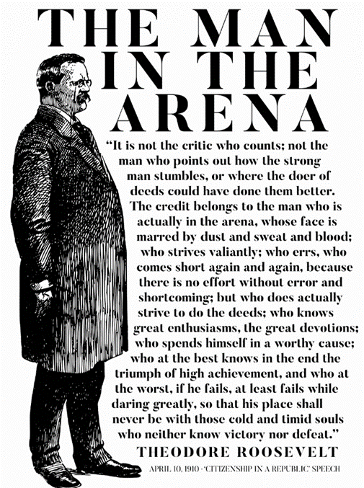



Slide 3
Purpose
Why are we having a RTP and what is it?
  We are having a pause to take time to connect with our airmen on a level we typically don’t on a drill weekend. This Pause is an effort to prevent suicides, help airmen feel more connected, improve meaning in their lives, and increase help seeking behavior.
  Without this Pause, our projected suicide rate for this year is over 150 Airmen. We are working to prevent suicides that could affect our airmen by having open conversations, connection, and empathy.
  We are working to create an environment with vulnerability and open conversation to increase unit connectedness, vector command climate, identify homegrown solutions for Airmen well-being, and decrease/remove barriers/stigma for help seeking.

Slide 4
Shame is a Strong Indicator of Suicidal Thoughts
Shame is the intensely painful feeling or experience of believing that we are flawed and therefore unworthy of love, belonging, and connection.
Current neuroscience research shows that the pain and feelings of rejection that shame inflicts are as real as physical pain.
Shame’s top tapes: Never good enough
Who do you think you are?

Slide 5
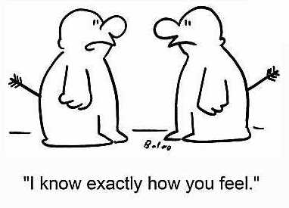
Empathy and Connection is the antidote to shame!
Empathy is connecting to the emotions that underpin the experience.

Slide 6

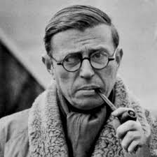
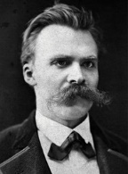
Meaning is a Good Preventative
A strong WHY will help you overcome anything else
more than the fittest body, the sharpest intellect, and all of Bill Gate’s money.
What’s your why?
  - What gets you up in the morning?
  - What makes life meaningful to you?
  * Many find this is linked with beliefs or spirituality.
If your why is lacking or rusty,
maybe it’s time to circle back around and re-attack.
Can you talk about your why ?
“He who has a why to live for can bear almost any how.”
Friedrich Nietzsche

Slide 8
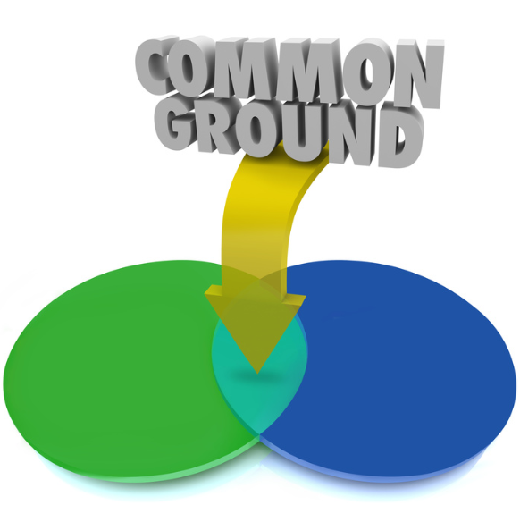
Creating space for a rumble
Things that get in the way:
  Unsolicited advice giving
  Interrupting
  Sharing outside the meeting/team
  Judgement
Things helpful for a rumble:
  Listening
  Staying curious
  Being honest
  Keeping Confidence
  Withhold Judgement

Slide 9

Protection
  There is a strong likelihood that there will be members of your group who have been touched directly or indirectly by this topics
  This may prompt some to be more vocal and others more introverted, be sensitive to what may drive either behavior
  Don’t insist that quieter people speak
  Watch for eye-contact, facial expressions, and subtle motions that the quieter people might make when they are ready to talk — and then ensure that have a chance to speak
Notes:
Protection
There is a strong likelihood that there will be members of your group who have been touched directly or indirectly by this topics
This may prompt some to be more vocal and others more introverted, be sensitive to what may drive either behavior
Don’t insist that quieter people speak
Watch for eye-contact, facial expressions, and subtle motions that the quieter people might make when they are ready to talk — and then ensure that have a chance to speak
“I know this is a hard topic for some people to talk about. I just want to reiterate that we really want to hear everyone’s perspective, with as much as they feel comfortable in sharing.”

Slide 10
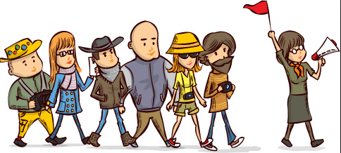
Guide the Discussion
  Focus on the group
  Focus on improvement – ask for ways to improve “here is how to make it better”
  Summarize what is being said
  Ask questions to open up discussion or to think about new directions

Slide 11
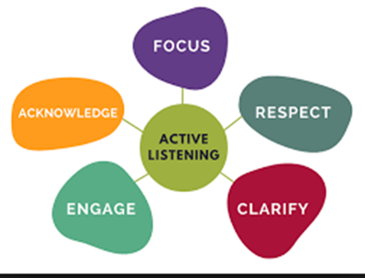


Group Discussion Tips
Notes:
Focus on the group process
Is the group repeating itself?
Are all members who wish to participating?
Is the discussion staying on track and on time?
Focus on improvement – ask for ways to improve “here is how to make it better”
Summarize what is being said
Ask questions to open up discussion or to think about new directions
Closed-ended questions (yes/no or factual) are useful for summarizing or reality checks
Open-ended questions (how, what, why, tell me, describe) draw people out
Establish ground rules for the discussion so that the participants feel the environment is safe to speak about their ideas and feelings.
Ground rules should be explicit
Ask the group if these rules make sense and if everyone can honor them
The following are some suggestions (create your own list):
We ask that you speak from your own perspective
We ask that you respect the viewpoints of others
We ask that you maintain confidentiality about what is said in the room during this discussion
To show your respect for others in the room, we ask that you stay focused on the discussion and avoid side conversations
We ask that you be willing to voice disagreements, but we ask that if you disagree with someone's idea that you criticize the idea, not the person
We ask that you don't interrupt each other
Active listening/paraphrasing
Paraphrasing means repeating the essence of what a participant has said in order to make them feel understood
Sometimes, this means summarizing a lengthy oratory, and making it concise and clear so that others can understand it
“So, what you’re saying…”
Check for Meaning
As this topic can make people uncomfortable, sometimes an individual will make a statement that sounds combative, even when they don’t mean it that way
Make sure you understand what they’re saying and avoid getting defensive or combative yourself
“Are you saying…? I’m not sure that I understand what you mean.”

Slide 12



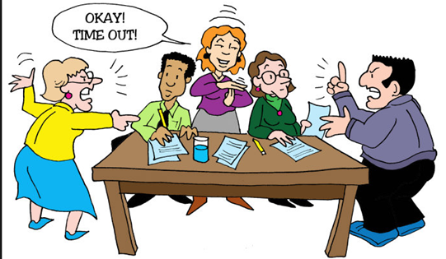
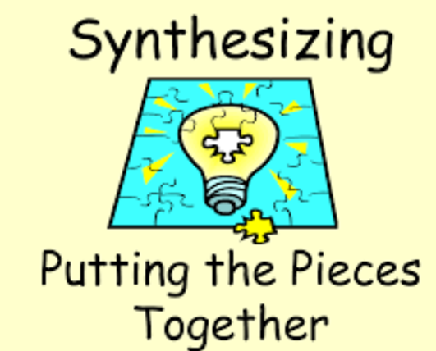
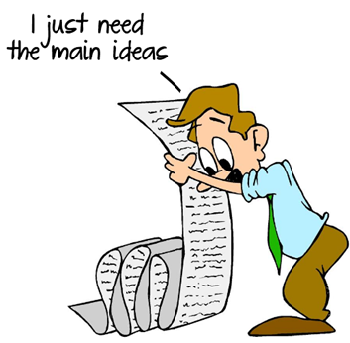
Group Discussion Tips
Give Positive feedback Redirection Expand
Relieve Tension Synthesize Summarize
Notes:
Give Positive feedback
Compliment an interesting or insightful comment
Always thank people for sharing
“That’s a good point. I’m glad you brought that to our attention.”
“That’s interesting. I’m glad you shared that, because if you’re thinking that, it’s possible others could be too. Does anyone else share that belief?”
Redirection
Sometimes the point may not be a good one or may take you way from the goal of that segment.
“Okay. I get how you would want to know that (or talk about that) but I think we need to stay focused on the topic at hand. If we have time later, we can return to that idea, or feel free to ask me about that after the group.”
“I appreciate your willingness to share a personal example, but as we don’t have a lot of time during the group, let’s get back to the topic and maybe you and I could discuss your experience after class.”
Give a two-minute warning or some other transition time to prepare the group to change direction
Expand
Elaborate on a participant’s contribution to the discussion with examples, or suggest a new way to view the problem.
“Your comments provide an interesting point. How do you think other might perceive the situation?”
Tell me more
Devil’s Advocate
Disagree (respectfully) with a participant’s comments to stimulate further discussion
“I can see where you are coming from, but I’m not sure that what you are describing is always the case. Can you (or another participant) play “Devil’s Advocate” with me, and argue the opposite of what you just stated.”
Relieve Tension
Mediate differences of opinion between participants and relieve any tensions that may be brewing
“I think that the two of you are not really disagreeing with each other but are just bring out two different perspectives about a tough issue.” Synthesize
Pull together ideas, showing their relationship to each other
“What you’re saying now ties back to what we discussed at the beginning…”
Summarize
Summarize (and record) the major view of the group
“So here’s what you’re saying…”
Containment
Sometimes, one or more individuals will try to “run the show”, dominating the discussion
It’s important that you make the room a safe place for all, and that will mean containing the big talkers
“Again, you are bringing a lot of really interesting stuff to the table. But if you could help me out, I really want to make sure everyone gets a change to contribute. I promise we’ll get back to you.”
"In order to accomplish our goal today, we really need to move on. Perhaps we can go back o this topic later.“
Avoid statements like, “Let’s hear from someone else other than Rick.” Instead, if you determine you have 1-2 louder people in the group, set a broader expectation like, “Let’s hear perspectives from four different people on this.”

Slide 13
Comments & Discussion Questions from Gen Goldfein
1. A young person who had just lost a high school friend to suicide stated, “Young people often see themselves as a burden to others. Their family, their friends, their unit, the Air Force…so killing themselves in their mind is a way to remove themselves as a burden.”
Does leadership see Airmen as a blessing or a burden?
How do Airmen see themselves?
2. Our “command team” sets the culture of an organization. Organizations take on the personality of a new commander within 6 weeks of change of command and their squadron will focus on what the command team believes is important.
What does it mean to be part of your squadron?
How can Airmen connect with the mission and its importance, as a service to our nation?
How do Airmen and their families feel embraced and included?
How can Airmen be made to feel a part of something truly special?

Slide 14
Gen Goldfein Con’t
3. Do command teams know their Airmen and their families? What would help them get to know you?
4. Great organizations maintain high morale by having fun. By periodically gathering to celebrate their contributions to the mission and to highlight the accomplishments of their people in an inclusive and respectful way.
Do you feel like your squadron has fun?
How do they celebrate mission contributions?
How do they celebrate accomplishments of individual Airmen?
* Gen Goldfein’s Letter, dated 31 Jul 2019, ended with “FIGHT’S ON!!”

Slide 15
Building Connections
How do you feel connected to other Airmen, friends, etc.?
How do we demonstrate good Wingmanship daily?
Who do we reach out to when we are struggling with something big? Small?
How do we demonstrate our loyalty to one another?

Slide 16
The beating heart of the Air Force…Squadrons!
How are you overwhelmed at work?
How does our mission make a positive impact?
How is our trust and confidence in each other? Leadership?
What can our unit do to improve our well-being?

Slide 17
Barriers and Stigma to Care
What stops you from seeking help?
What are we doing well in terms of helping resources?
Where do you go for information and help?
What base helping resources are working?
What can we do to help ourselves? Our teammates? Our families?

Slide 18

Airmen Feedback Matters
How do you like to provide feedback?
How do you like to receive feedback?
Where can the AF be more effective in
this area?
How can the AF do it different or better?

Slide 19
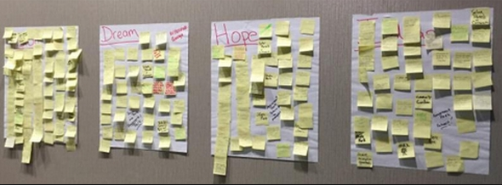
Feedback
Record the discussion in a visible way
Notes:
If possible, consider recording the discussion in a way that is visible to the group
Using flip charts or having people write their thoughts on sticky notes and adding them under the topics can be great visuals of the feedback
Having the discussion visible helps the group to see the progress it's making and to refer back to earlier comments
Note: Whenever possible, use the speaker's own words, and be sure to record everyone's comments to avoid creating tension and resistance
Note: Having someone else write and capture ideas while you facilitate might be helpful

